Slide 1
Incident Response Process

Slide 2
Incident Response Process
The incident response lifecycle
Preparation
Identification
Containment, Eradication, and Recovery
Lessons Learned

Slide 3

Preparation
Phase that occurs before the incident
All the tasks needed to be organized and ready to respond to the incident
Then it becomes a manageable task
Without preparation, this task can be impossible or incredibly expensive
Everyone needs to know their roles and what to do

Slide 4

Identification
Someone suspects something is wrong and notifies the incident response team
Can be done by anyone on the team, essentially whoever finds the anomaly
An incident can be defined as a situation that is different from normal/routine operations
One of the first key steps is gathering the information and determining if the incident response process should be activated

Slide 5

Containment
After the identification, prevention of the incident from spreading is the first step
Makes handling the incident much easier
Containment is a set of actions taken to constrain the incident to the minimal number of machines

Slide 6
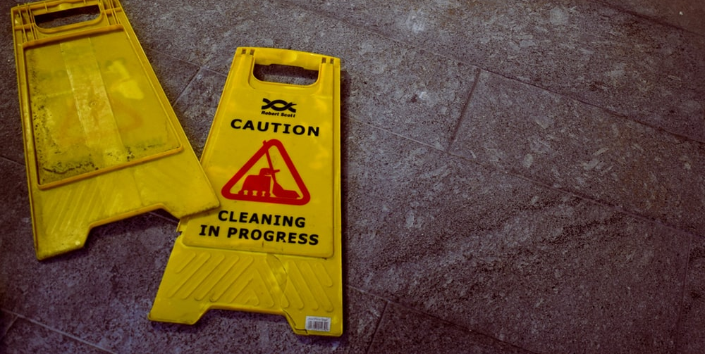
Eradication
Eradication is the process of removing the problem
Might mean rebuilding a clean machine
This involves not only removing, but also the prevention of reinfection

Slide 7

Recovery
Before this step, the investigation has to be complete and documented
Recovery is the process of returning the asset into the business function and restoration of normal business operations

Slide 8

Lessons Learned
Assign action items to correct weaknesses
Suggest ways to improve
Happens “post-mortem”
Document what went wrong and allowed the incident to occur
Examine the incident response process

